Slide 1


LO VAN HIEN
MY SUDENT ID : BKC12444
MOBILE NUMBER: 0326660728
CLASS : BTEC D02K12

Slide 2

ALGORITHMS IN PROGRAMMING
CONTENT
General definition of algorithm
What is algorithm ?
The importance of algorithms in programming.
Example algorithm
Some commonly used algorithms in programming
Quick Sort Algorithms
Binary Search Algorithms

Slide 3
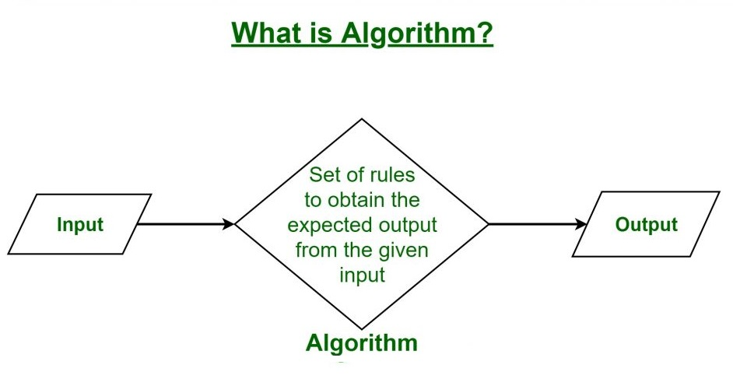
General Definition Of Algorithm
What is an Algorithm ?
An algorithm is a step procedure to solve logical and mathematical problems.
A recipe is a good example of an algorithm because it says what must be done, step by step

Slide 4
The Role Of Algorithms In Programming
Algorithms are an important indispensable part of approaching programming-related issues.
Good algorithms bring high efficiency, helping programs operate efficiently with fast processing speed, saving resources.
The algorithm helps programmers better and deeper understand applications and program.

Slide 5
Example Algorithm
This is a program that calculates the total number a and b:
Enter variables a and b
Sum them and save the result in the variable sum.
Display sum

Slide 6
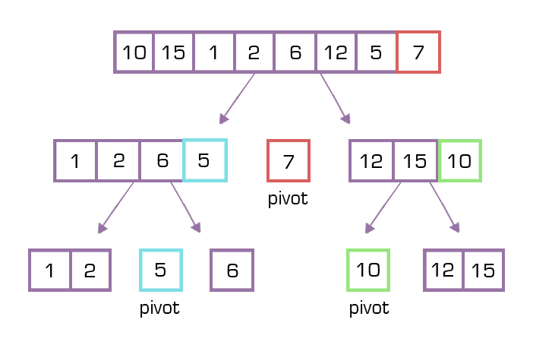
Some Commonly Used Algorithms
What is Quick Sort Algorithms ?
The Quick Sort algorithm is a split-to-rule algorithm. It selects an element in the array as a pivo. After selecting the pivo point, the next step will divide the array into multiple sub-segments based on the selected pivot. And repeat it again and again until the end.

Slide 7
The Speed of Quick Sort Algorithms
The speed of the Quick Sort algorithm is affected by the selection of the pivot
There are many ways to choose a pivot, here are some ways :
Select the first element of the array as a pivot.
Select the last element of the array as a pivot.
Select a valuable element in the middle of the array.
Randomly select an element in the array.

Slide 8
The Process Of The Quick Sort Algorithm
Step 1: Take an element in the array as a pivot
Step 2: Divide arrays by pivot element.
Step 3: Call recursives to sort the sub-array on the left
Step 4: Call recursives to sort the sub-array on the right

Slide 9
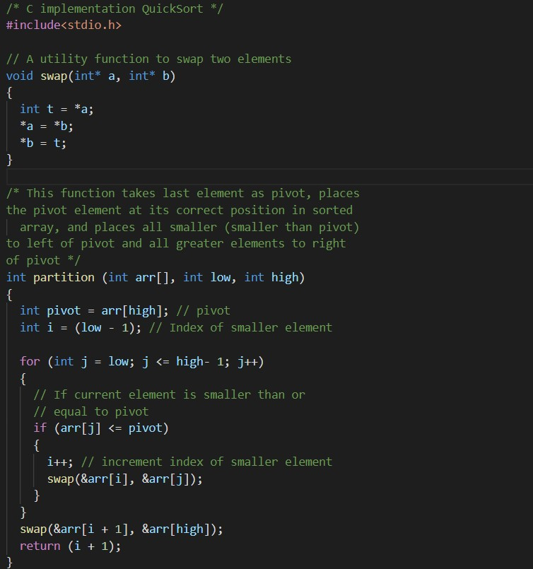
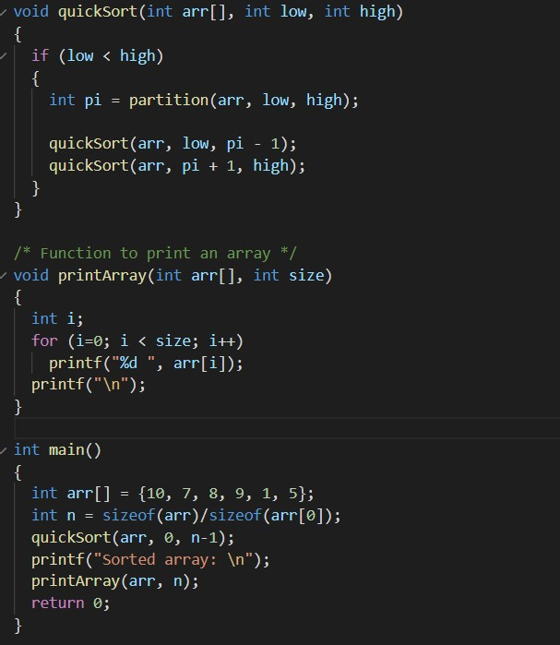

Example of Quick Sort Algorithm

Slide 10
Application Of Quick Sort Algorithm
Commercial computers: Used in government and private organizations for different data classification purposes such as account/file arrangements by name or by ID.
Information Search: Quick Sort algorithm that support faster and more efficient search for information

Slide 11
Quick Sort Algorithm Review
As the name implies, the quick sorting algorithm is an algorithm for fast, compact, light end. This algorithm is based on dividing an array into smaller arrays
If you compare the Quick Sort algorithm with other sorting algorithms such as Insertion Sort or Bubble Sort, the Quick Sort algorithm gives significantly faster speeds.
The complexity of Quick Short:
Quick Short's time complexity is O(n) , O(n log n) , O(n ^2)
Quick Short's spatial complexity is : O(n)

Slide 12
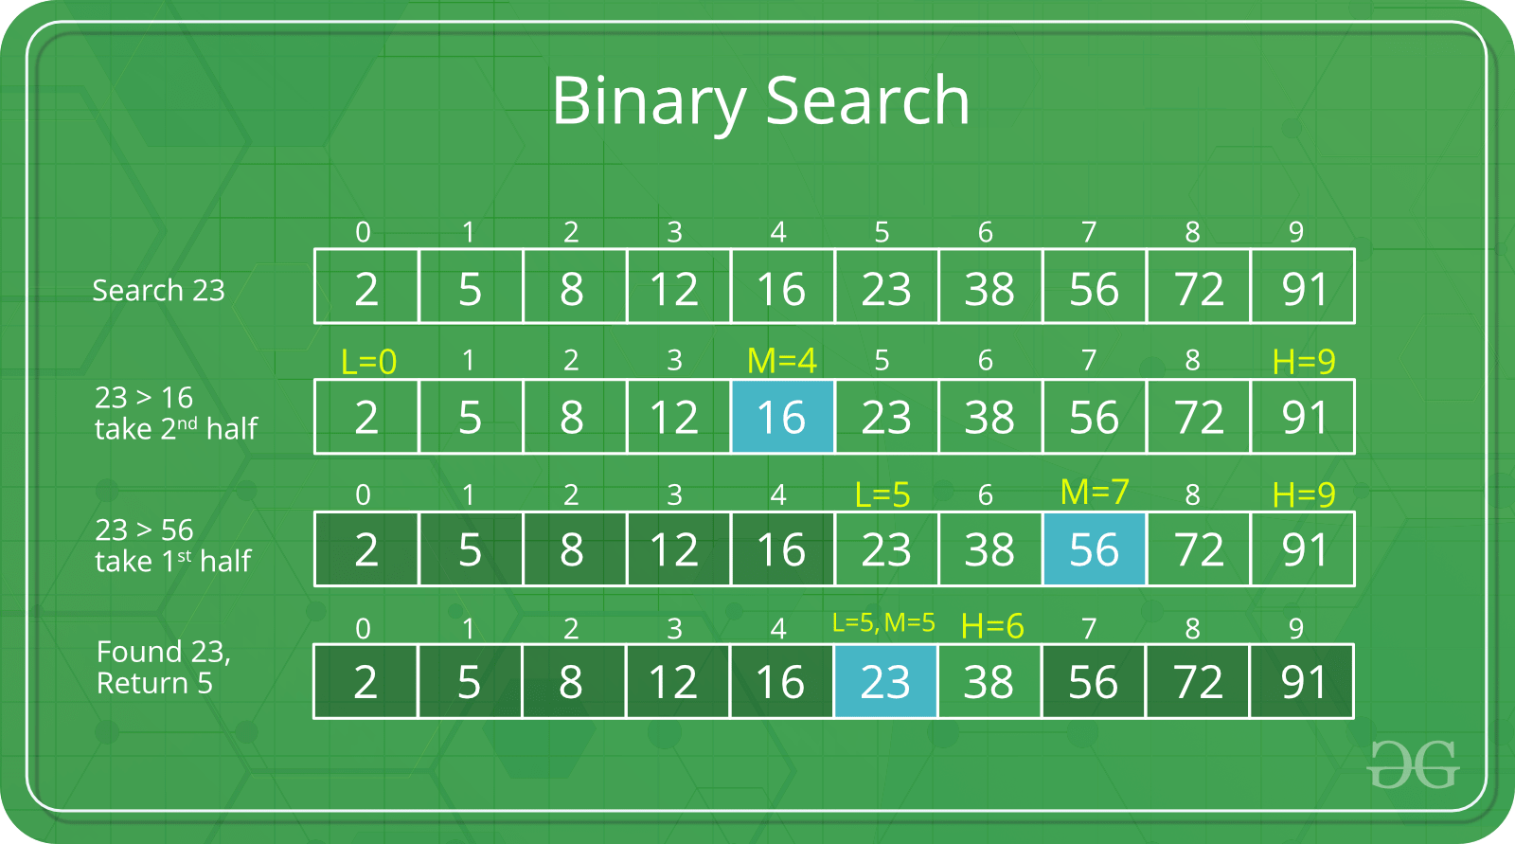
Binary Search Algorithms
What is Binary Search Algorithms?
Binary search algorithm, also known as half-interval search, is an algorithm that allows to find the position of an element in a sorted array.

Slide 13
The Process Of Binary Search Algorithms
Step 1: split the original pieces in half
Step 2: Start with a range, from the beginning of the array to the end of the array. If the value of the element to look for is less than the value of the word in the middle, then narrow the search range from the beginning of the array to the middle of the array and vice versa.
Step 3: Continue to do so until the array runs out or figure out where the element to look

Slide 14
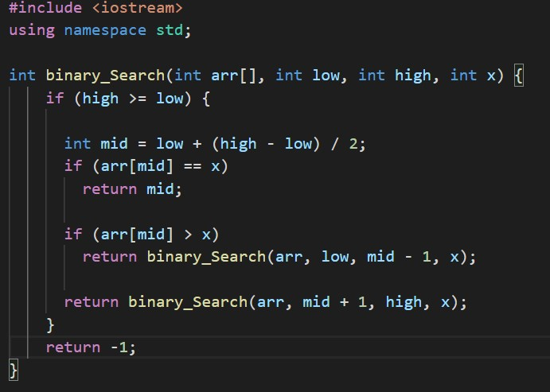
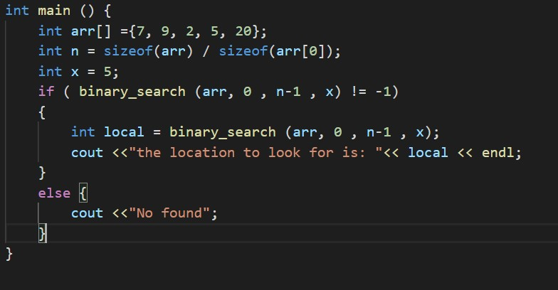
Example of Binary Search Algorithms

Slide 15
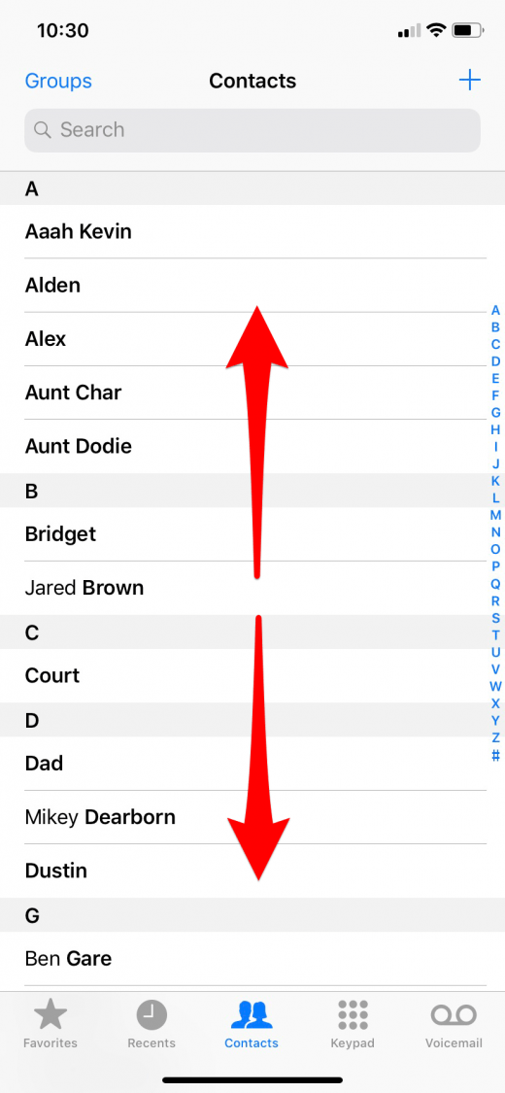
Application Of Binary Search Algorithms
Binary search algorithms are often used to search for elements in an arranged list, for example in a phone book sorted by name, which can search for a person's phone number by that person's name.

Slide 16
Binary Search Algorithms Review
Binary search only works on sorted arrays and suitable for arrays of length
If compared Binary Search with Linear Search Algorithm, Binary Search Algorithm has better performance
The complexity of Binary Search Algorithms
The average complexity of the binary search algorithm : O(log n)
Spatial Complexity : O(1)

Slide 17
THANK YOU FOF WATCHING

